Slide 1
Linear Algebra

Slide 2
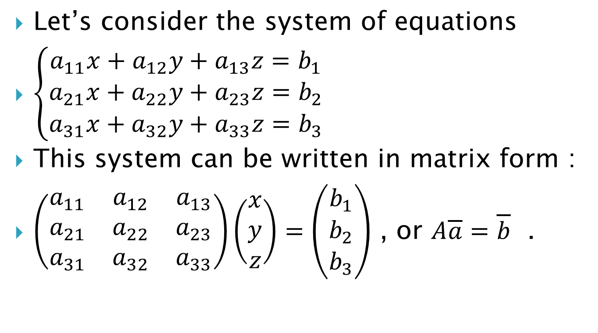
Linear Systems of Equations — Applications
Let’s consider the system of equations
$\left\{\begin{aligned}a_{11}x+a_{12}y+a_{13}z=b_{1} \\ a_{21}x+a_{22}y+a_{23}z=b_{2} \\ a_{31}x+a_{32}y+a_{33}z=b_{3}\end{aligned}\right.$
This system can be written in matrix form :
$\left(\begin{matrix}a_{11} & a_{12} & a_{13} \\ a_{21} & a_{22} & a_{23} \\ a_{31} & a_{32} & a_{33}\end{matrix}\right)\left(\begin{matrix}x \\ y \\ z\end{matrix}\right)=\left(\begin{matrix}b_{1} \\ b_{2} \\ b_{3}\end{matrix}\right)$ , or $A\overline{a}=\overline{b}$ .

Slide 3
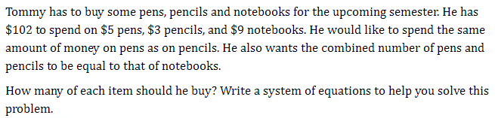
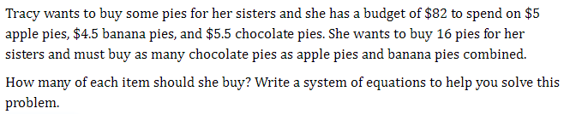
Example 1.
Example 2.

Slide 4
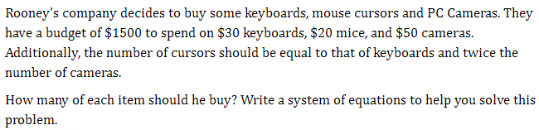
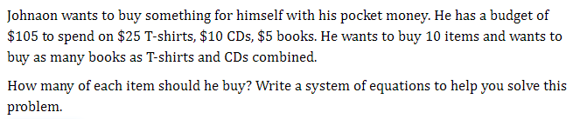
Example 3.
Example 4.

Slide 5
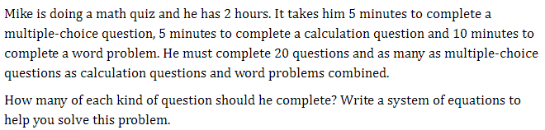
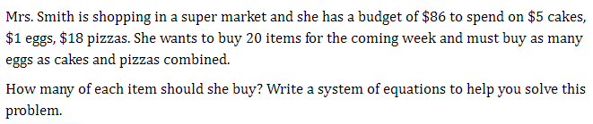
Example 5.
Example 6.

Slide 6
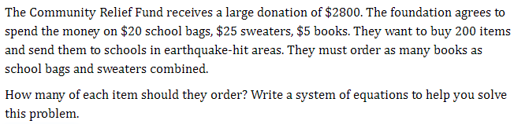
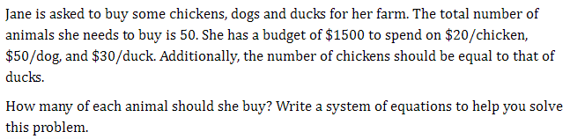
Example 7.
Example 8.

Slide 7
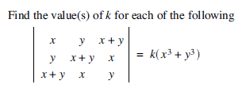
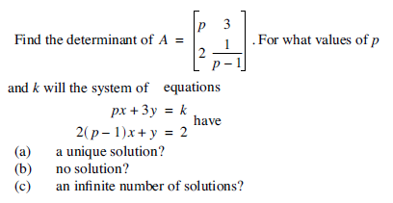
Example 9.
Example 10.

